Slide 1
Optical Flow

Slide 2
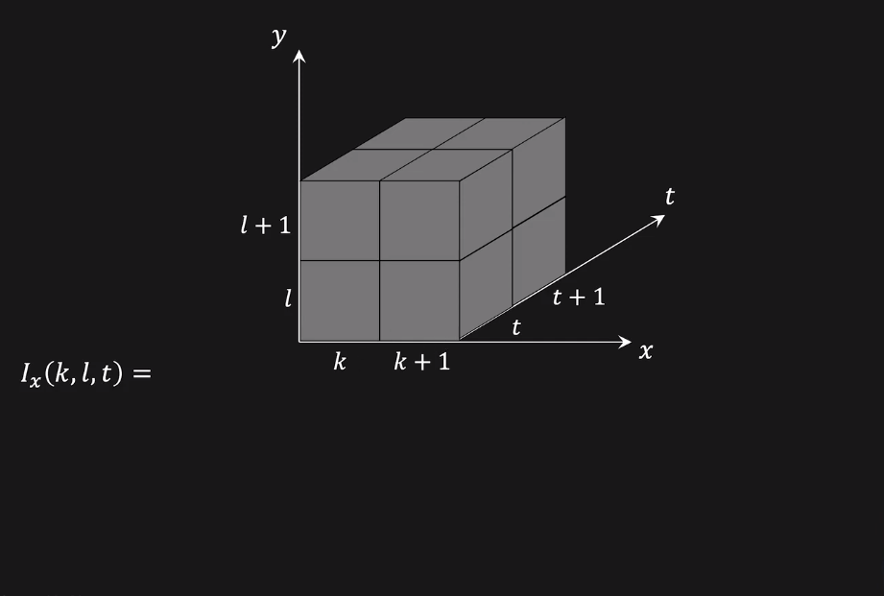
Computing Partial Derivatives Ix, Iy, It

Slide 3
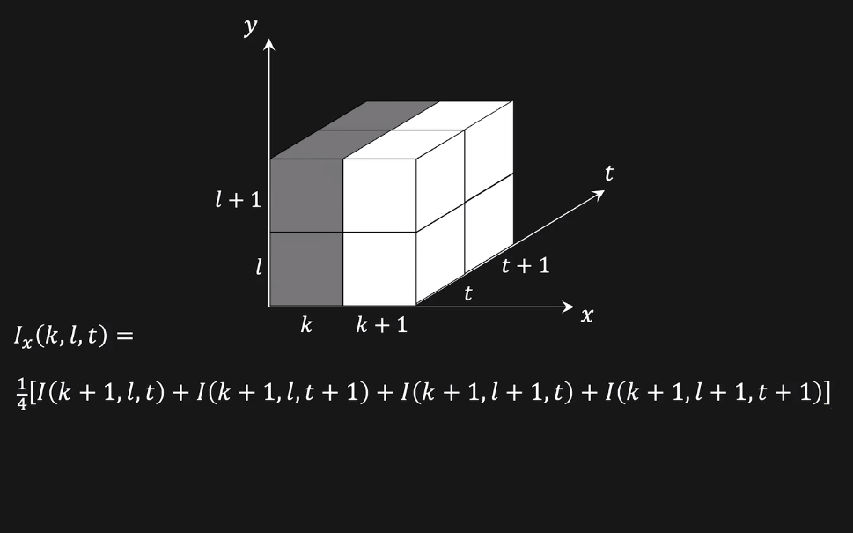
Computing Partial Derivatives Ix, Iy, It

Slide 4
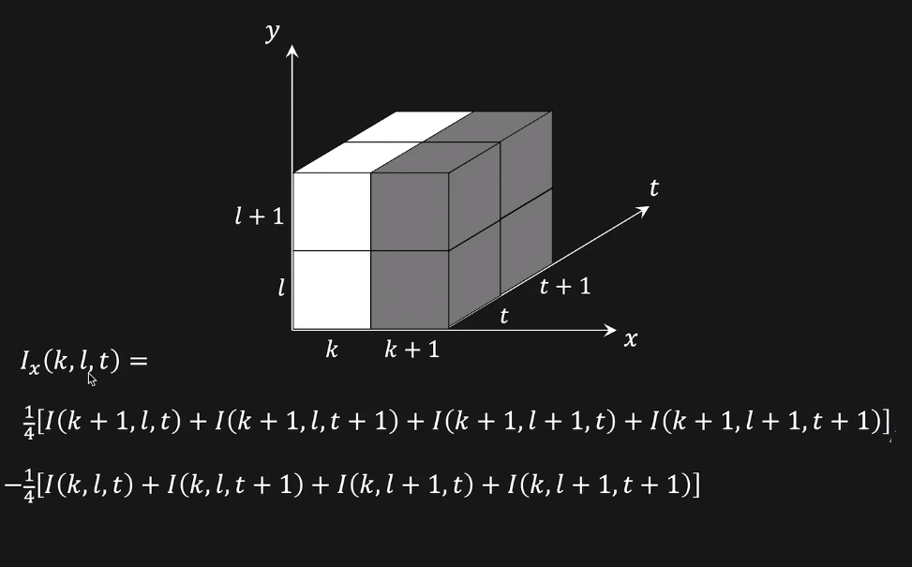
Computing Partial Derivatives Ix, Iy, It

Slide 5
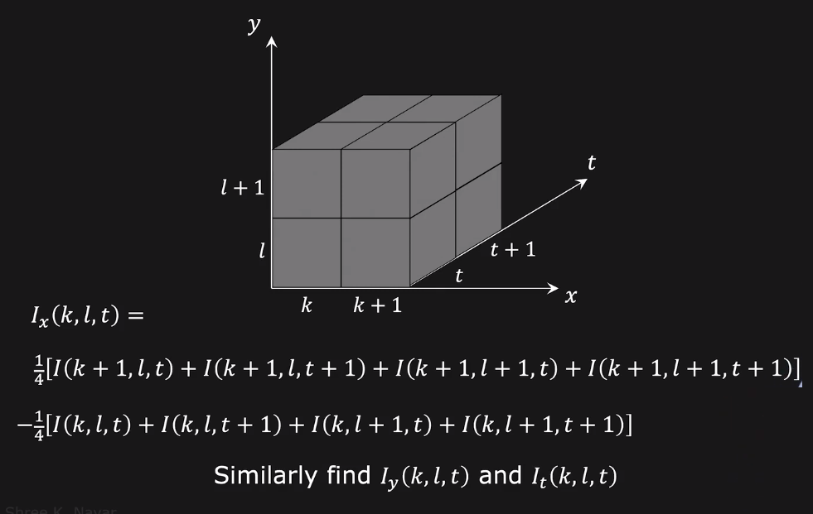
Computing Partial Derivatives Ix, Iy, It

Slide 6
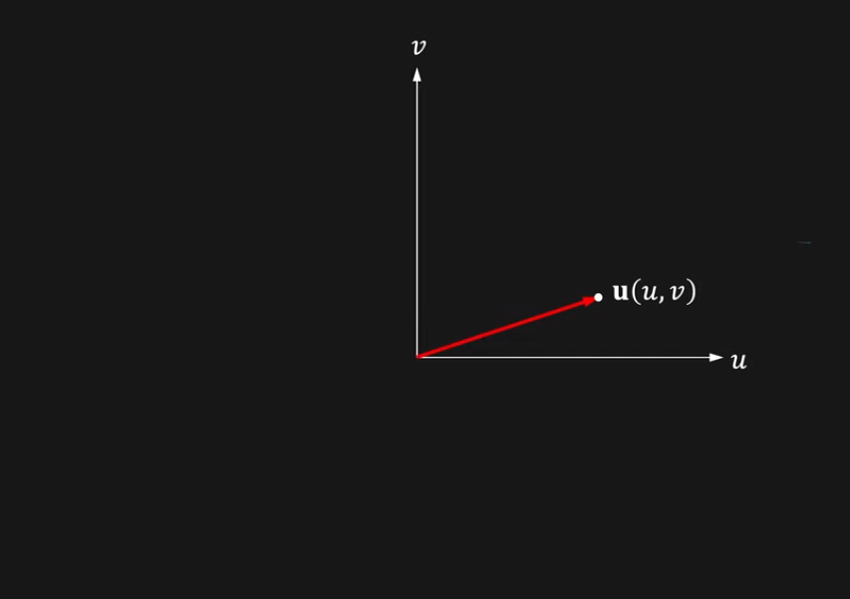
Geometric Interpretation

Slide 7
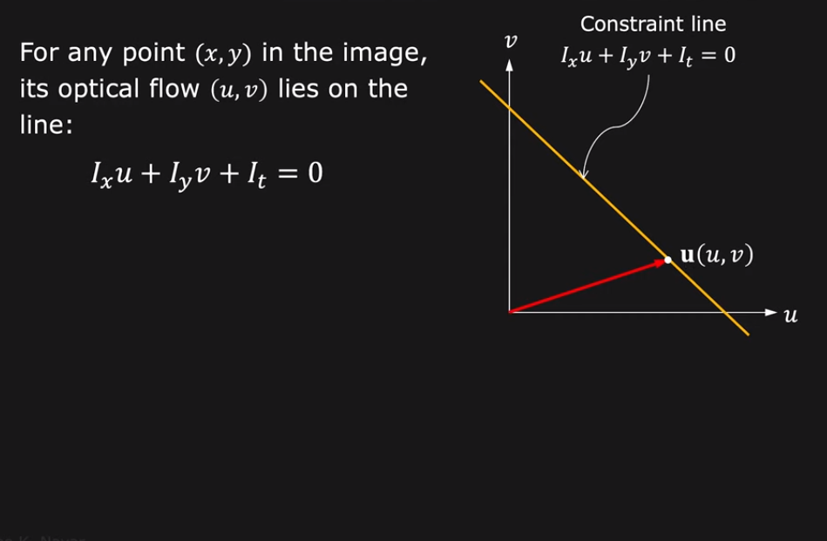
Geometric Interpretation

Slide 8
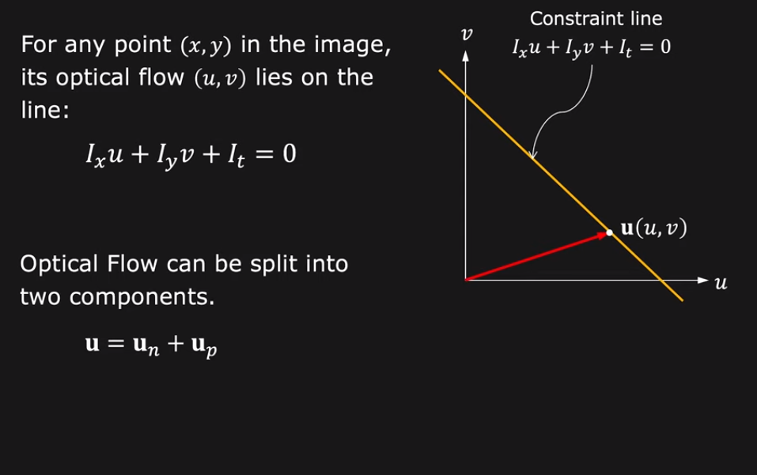
Geometric Interpretation

Slide 9
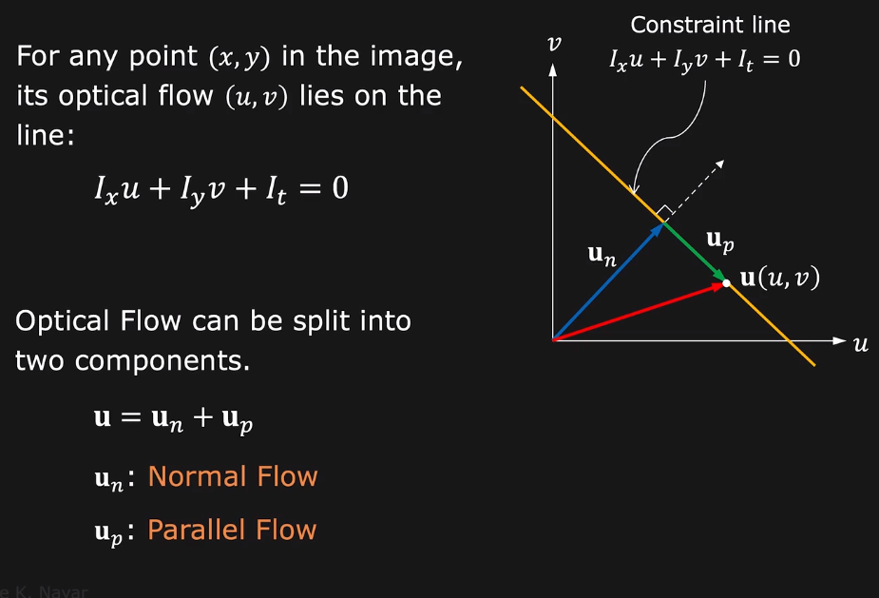
Geometric Interpretation

Slide 10
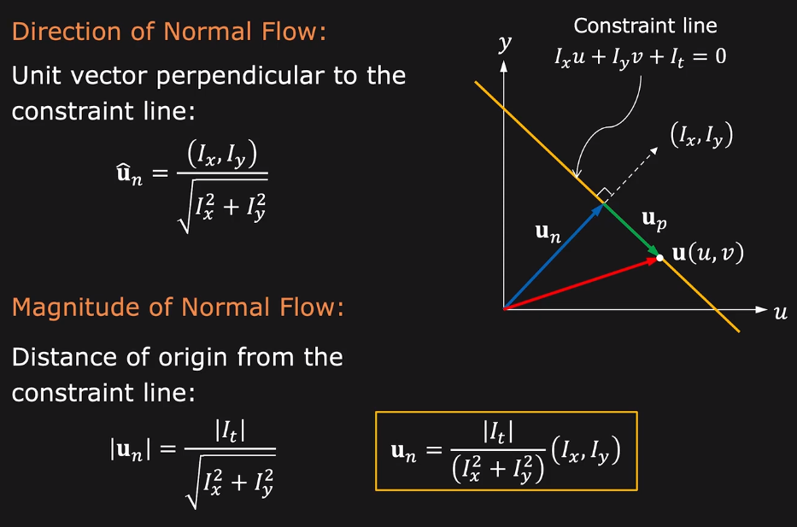
Normal Flow

Slide 11
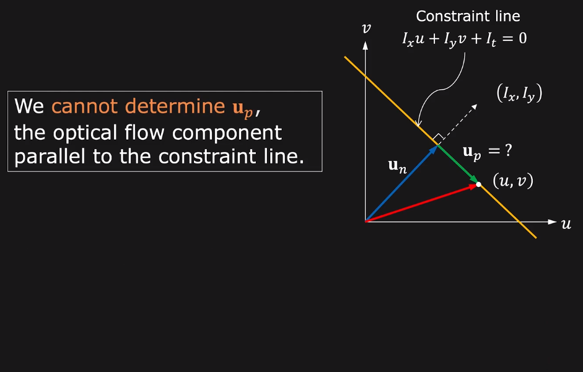
Parallel Flow

Slide 12
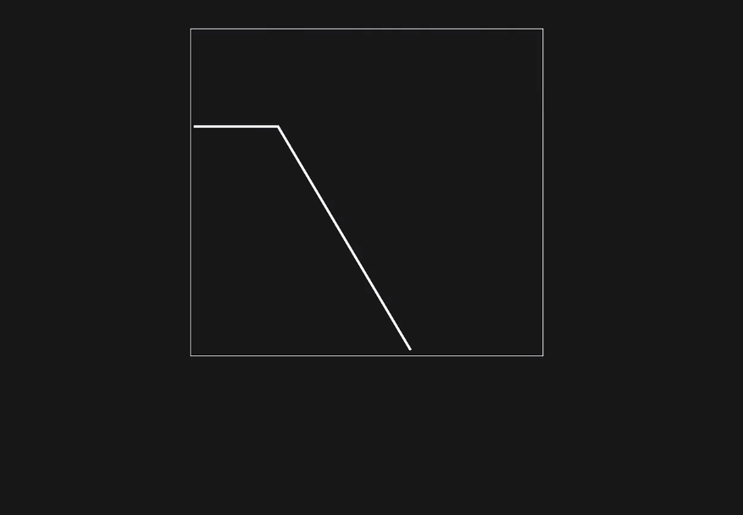
Aperture Problem in Optical Flow

Slide 13
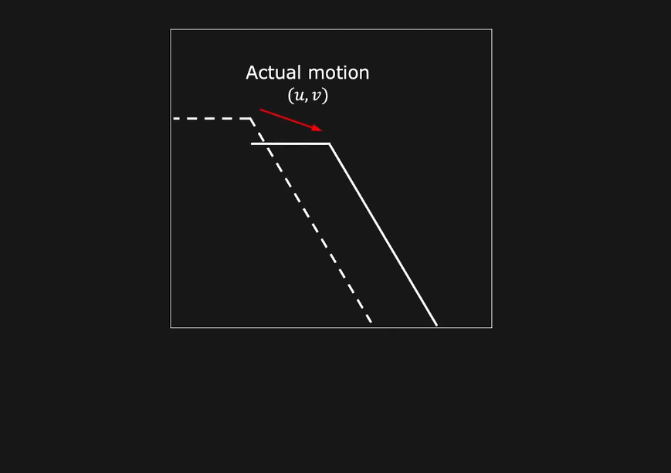
Aperture Problem in Optical Flow

Slide 14
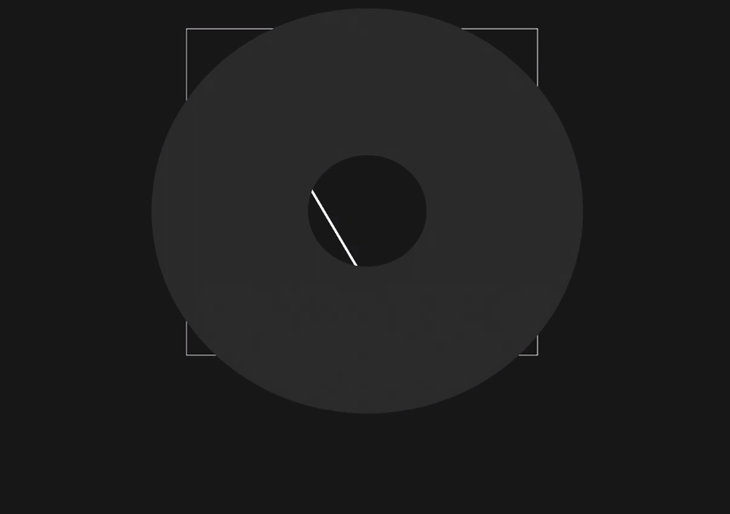
Aperture Problem in Optical Flow

Slide 15
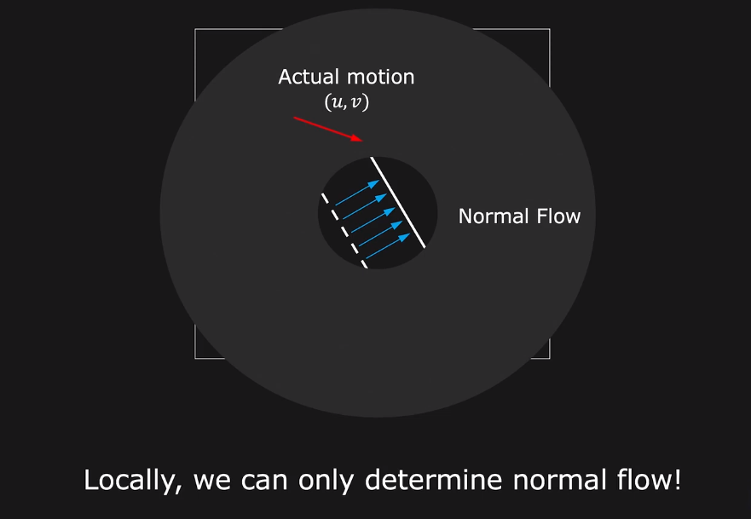
Aperture Problem in Optical Flow

Slide 16
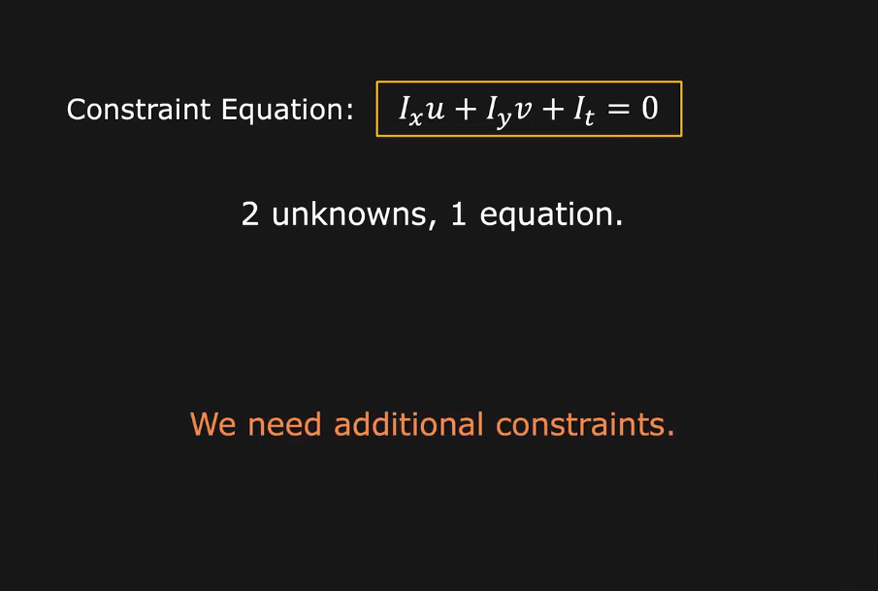
Optical Flow is Under Constraint

Slide 17
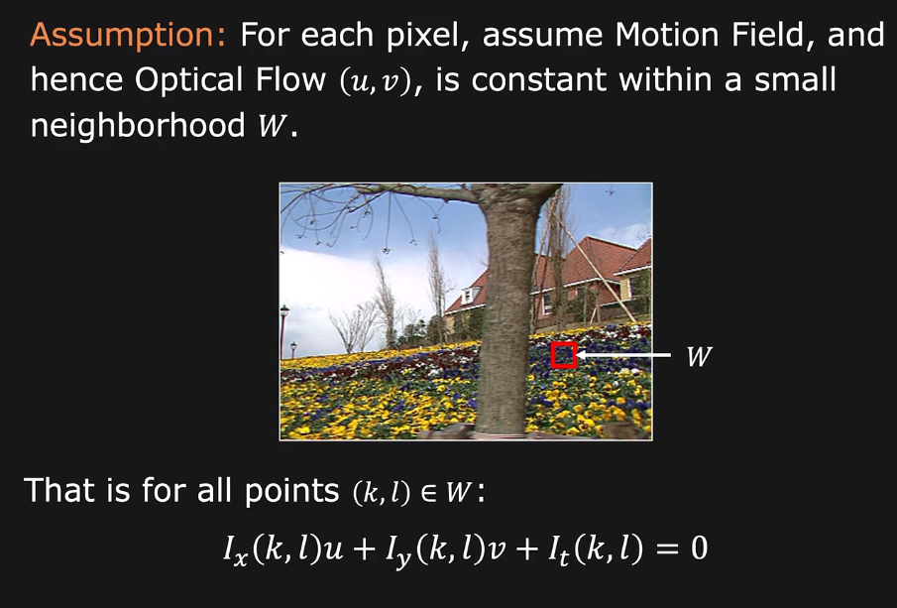
Lucas-Kanade Solution

Slide 18
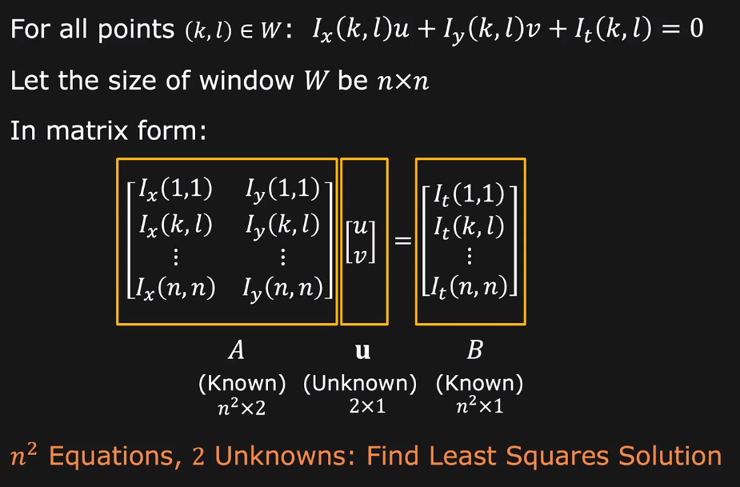
Lucas-Kanade Solution

Slide 19
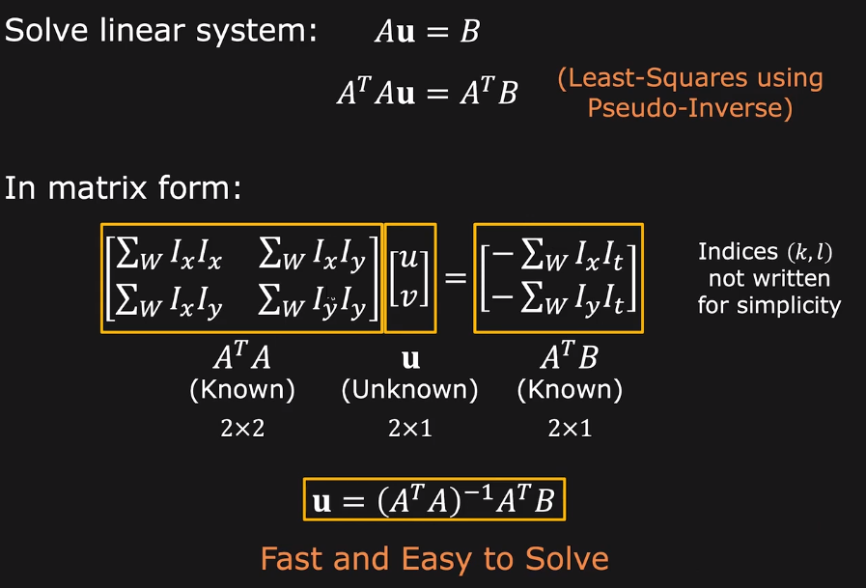
Least Squares Solution

Slide 20
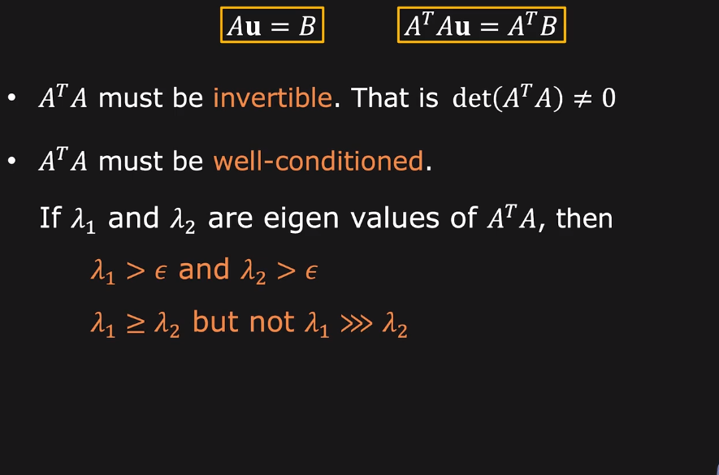
When does Optical Flow Estimation Work?

Slide 21
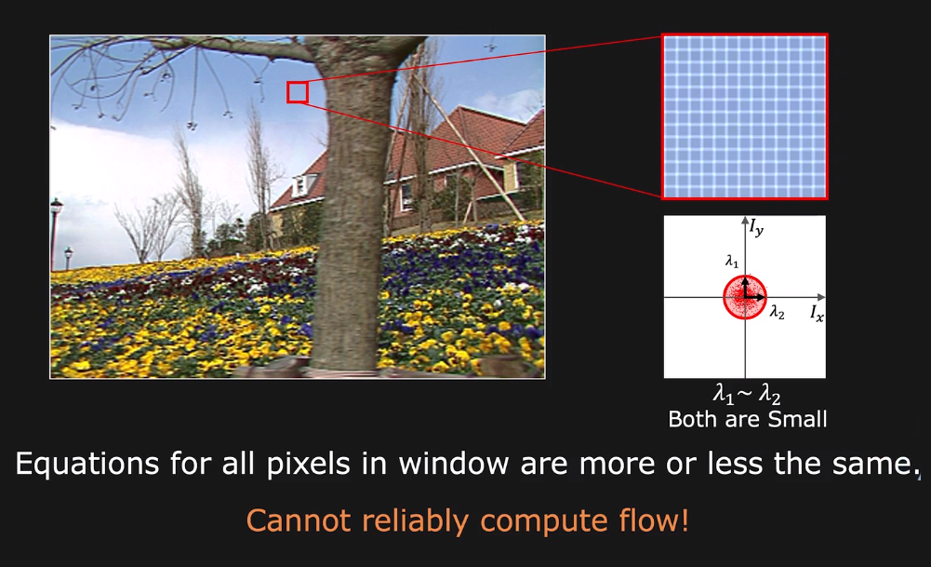
Smooth Regions (Bad)

Slide 22
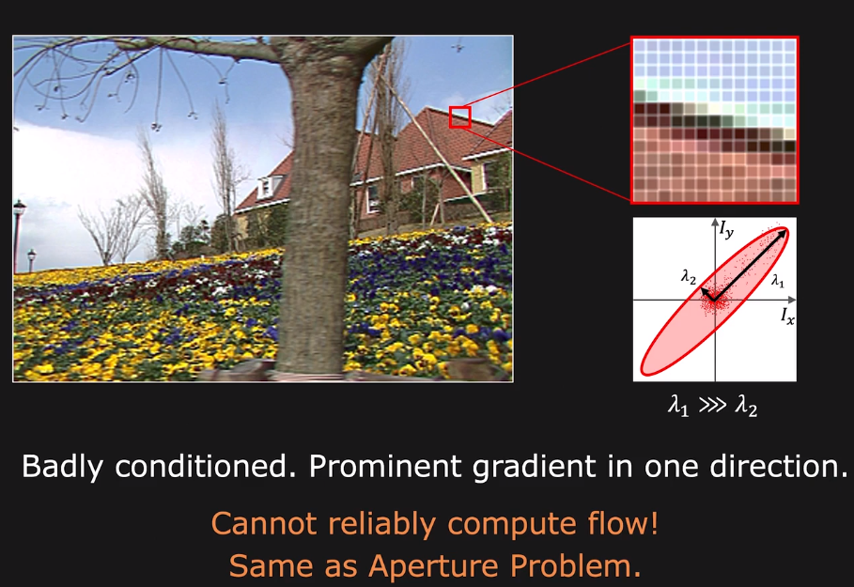
Edges (Bad)

Slide 23
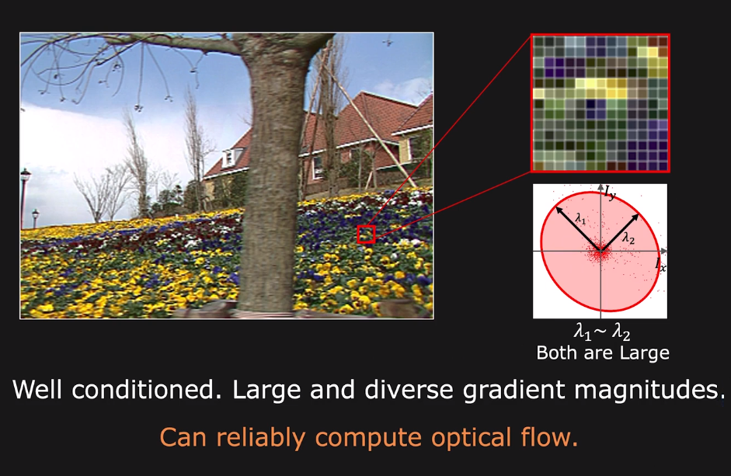
Textured Region (Good)

Slide 24
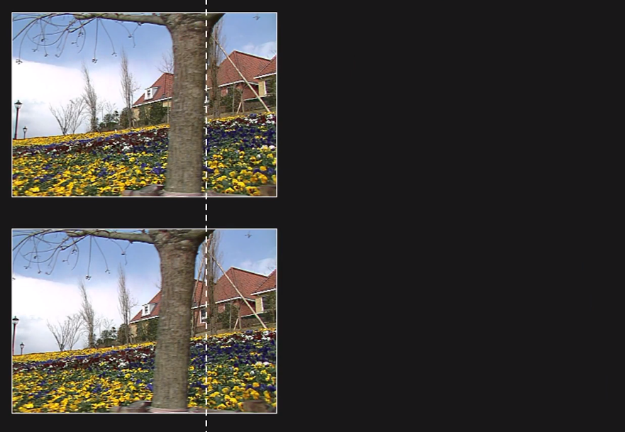
What if we have large motion ?

Slide 25
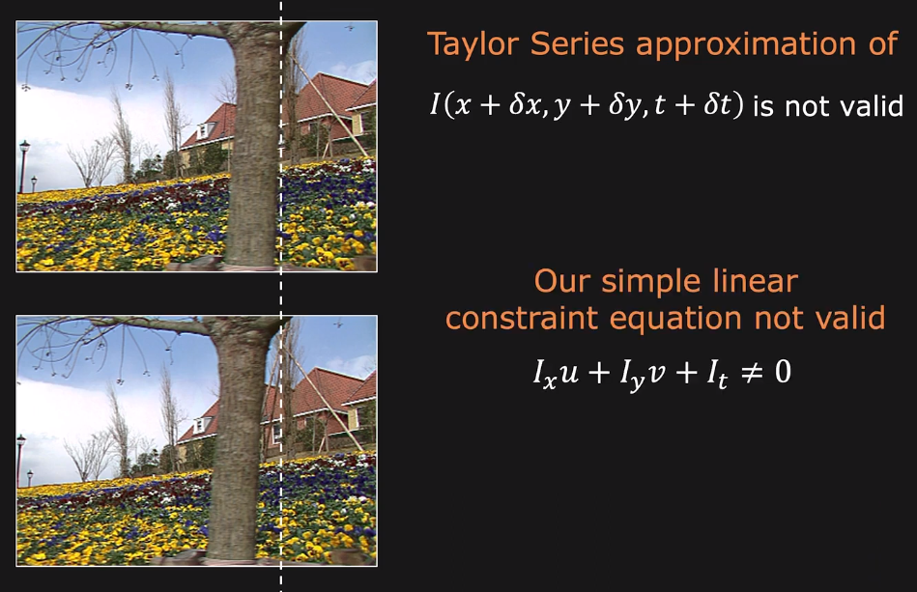
What if we have large motion ?

Slide 26
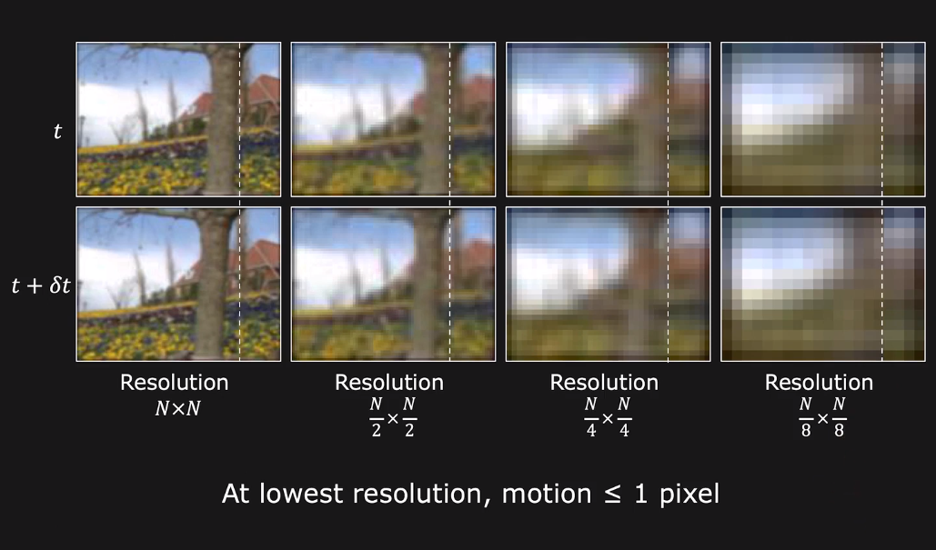
Large Motion: coarse-to-fine estimation

Slide 27
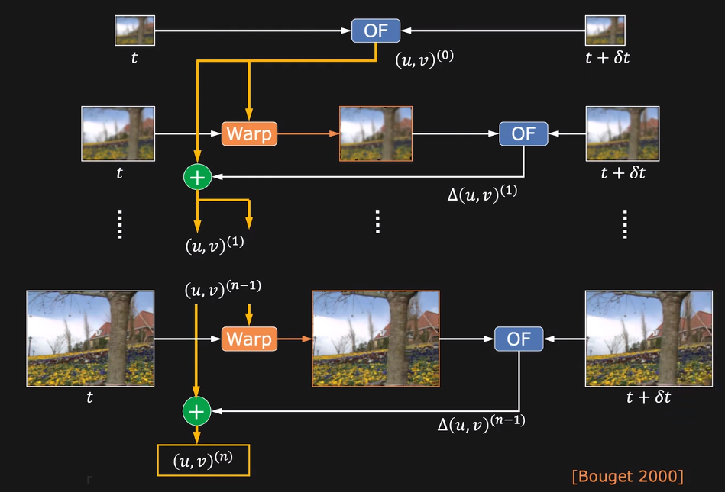
Coarse-to-fine Estimation Algorithm

Slide 28
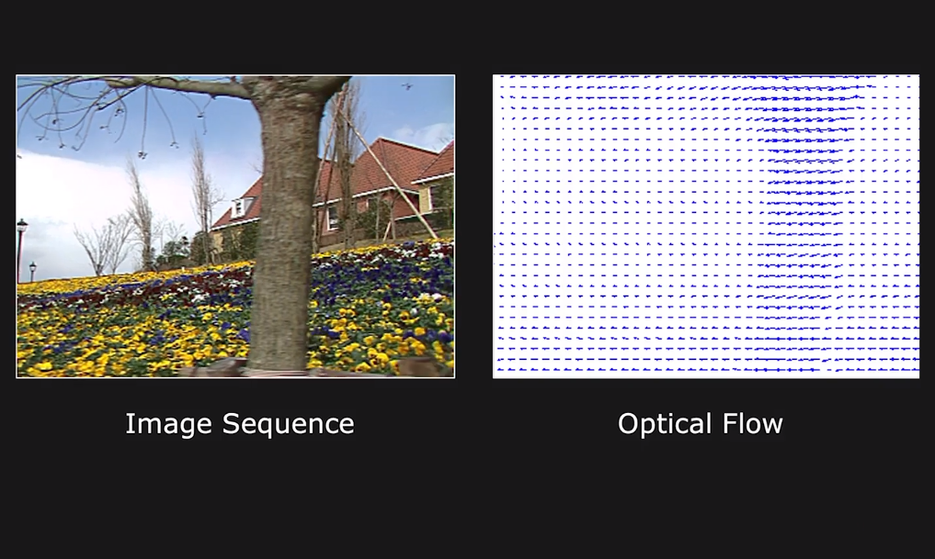
Results: Tree Sequence

Slide 29
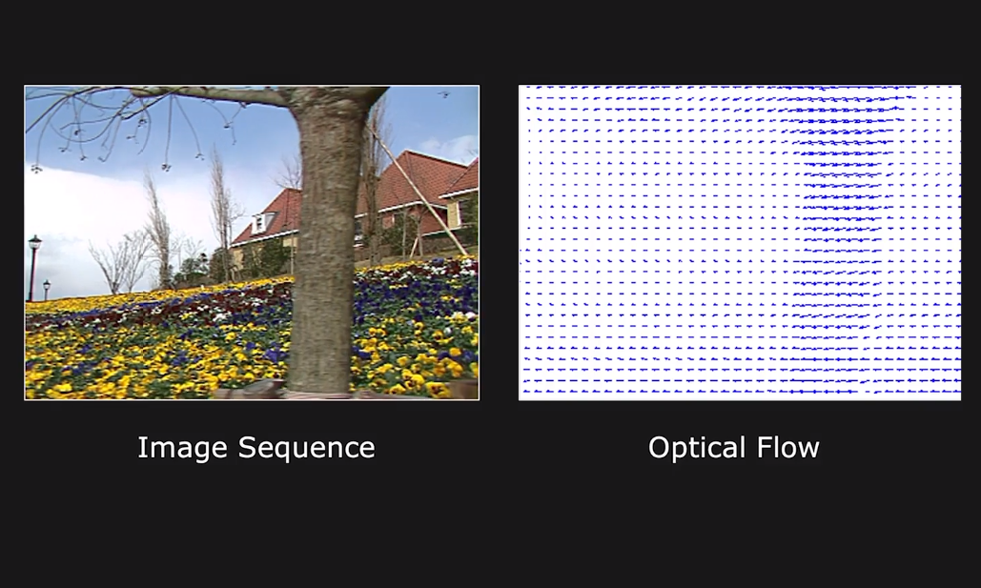
Results: Tree Sequence

Slide 30
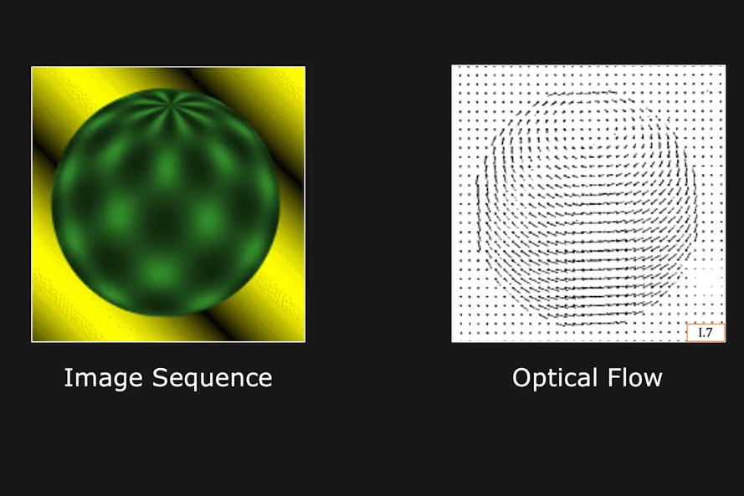
Results: Rotating Ball

Slide 31
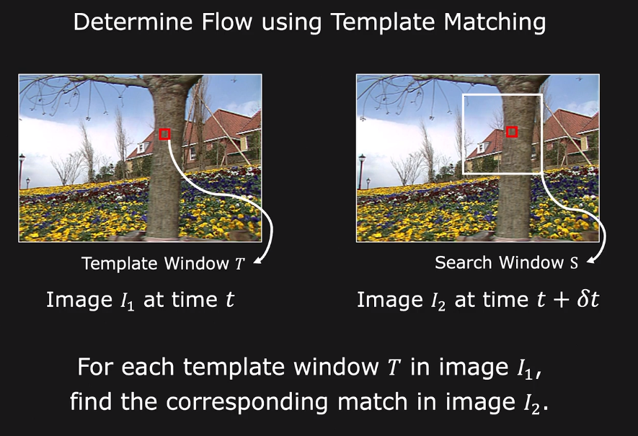
Alternative Approach: Template Matching

Slide 32
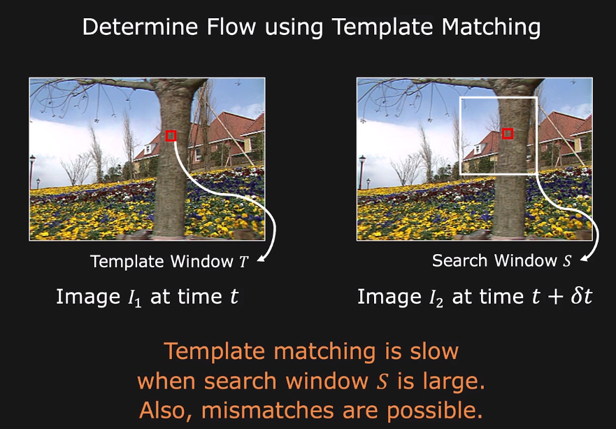
Alternative Approach: Template Matching

Slide 33
Thanks

